Slide 1
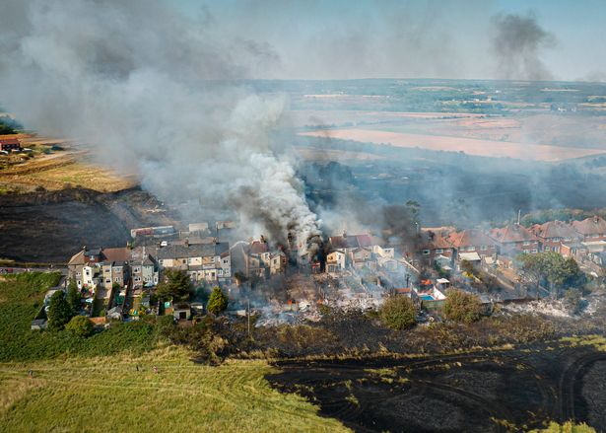
What Do We Know About Wildland Urban Interface Fires?
Prof Anna A Stec
Centre for Fire and Hazards Sciences
University of Central Lancashire
Preston, PR1 2HE, UK
aastec@uclan.ac.uk
Notes:
1

Slide 2
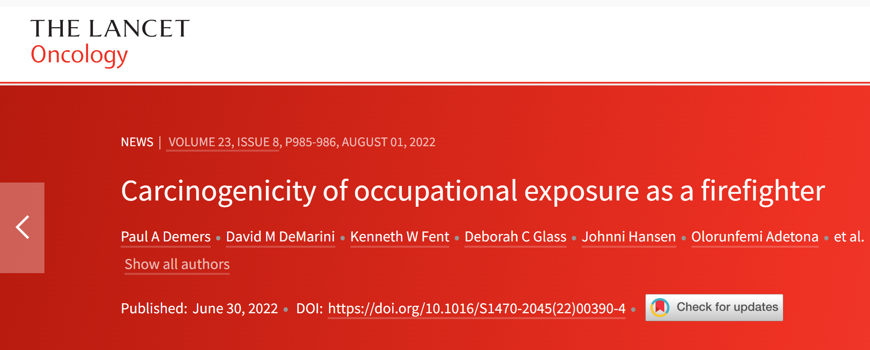
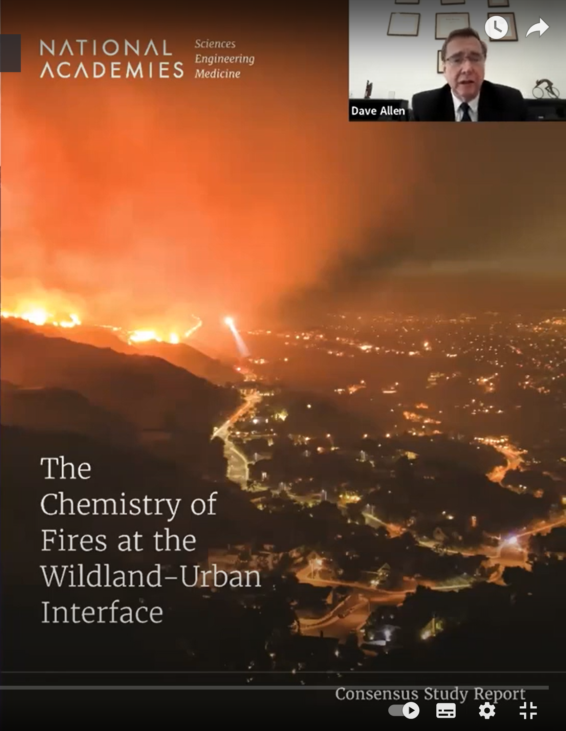
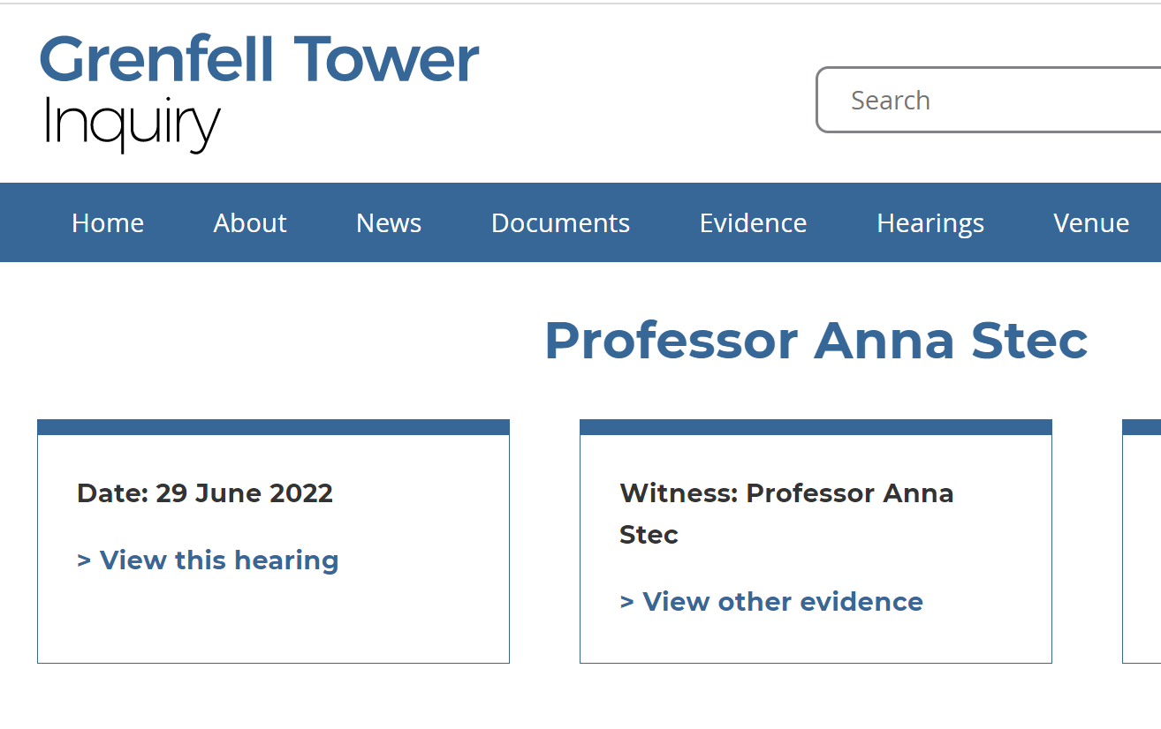
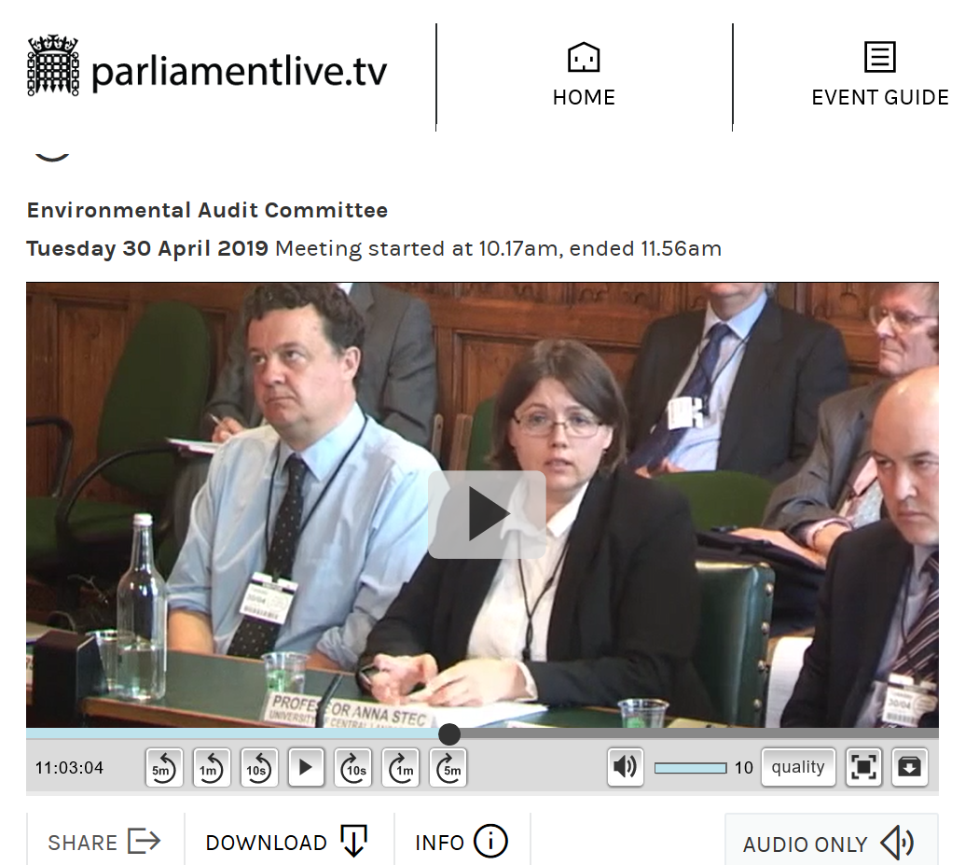
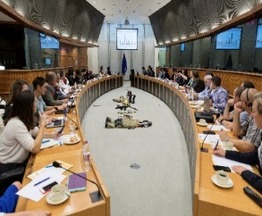
A little bit about me…….
Professor in Fire Chemistry and Toxicity at University of Central Lancashire
Member on the National Academies of Sciences, Engineering and Medicine, “The Chemistry of Urban Wildfires”, USA
Specialist on the International Agency for Research on Cancer Monographs, Volume 132 – ‘Occupational exposure as a Firefighter’, World Health Organization
Grenfell Inquiry Scientific Expert: to determine the fire derived toxicants and related deposits present in the Tower and their origins
Expert Witness on Environmental Audit Committee, Toxic Chemicals in Everyday Life, House of Commons, UK Parliament
European Parliament, MEPs Against Cancer (MAC), European Parliament Interest Group: Addressing the rate of cancers amongst firefighters
UK’s designated principal expert on Fire Chemistry to the ISO Fire Threat to People and the Environment subcommittee (ISO/TC92/SC3)

Slide 3
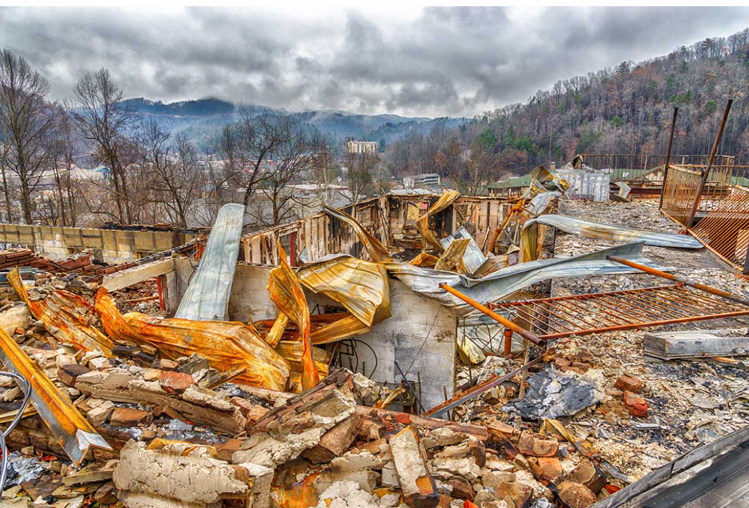
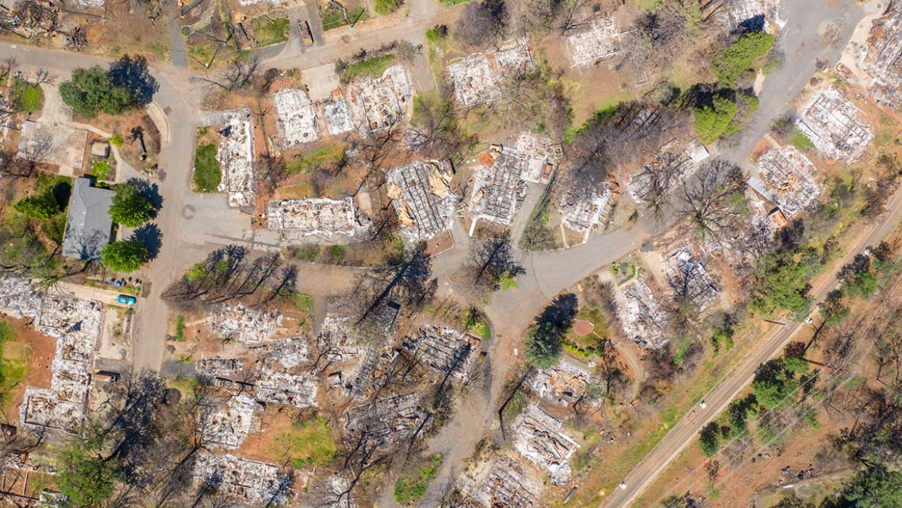
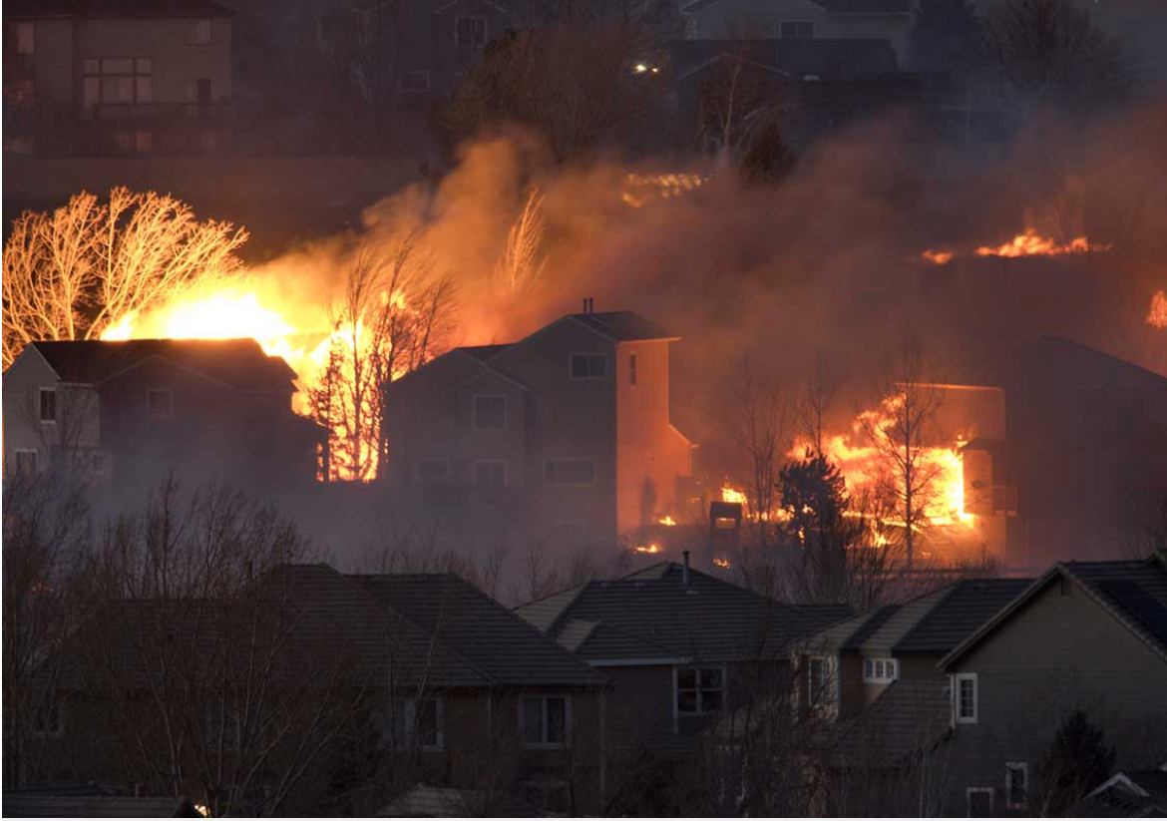
Wildland Urban Interface Fires
Wildfires in America are becoming larger, more frequent, and more destructive.
Many of these fires occur at the wildland-urban interface (WUI).
Public and environmental health effects are unique.
Chimney Tops 2 Fire 2016
Arson
14 fatalities
2,500 structures damaged
17,000 acres burned
Camp Fire 2018
electrical transmission lines
85 fatalities
18,804 structures damaged
153,336 acres burned
$ 16.5 billion in losses
Marshall Fire 2021
over 1000 structures damaged
over 6000 acres
Notes:
driven by climate change and existing land management practices.
areas which are increasingly at risk of devastating fires as communities continue to expand into previously undeveloped areas
Unlike conventional wildfires, WUI fires are driven in part by burning of homes, cars, and other human-made structures, and in part by burning vegetation. .

Slide 4

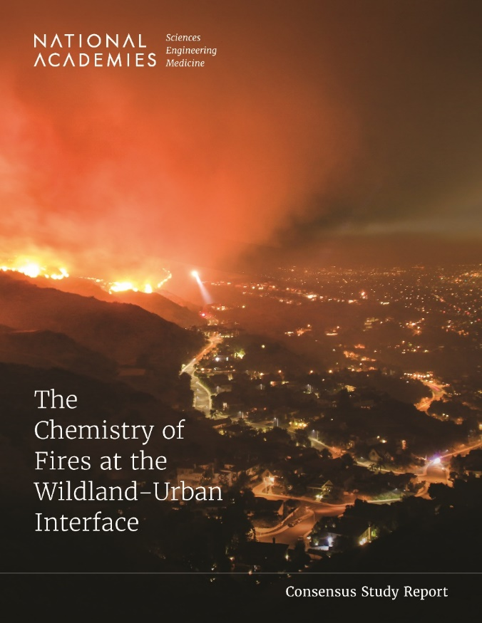
WUI FIRES
Report evaluates existing and needed chemistry information and recommends a research agenda to fill decision-critical gaps that decision-makers can use to mitigate WUI fires and their impacts on the general public.
  the chemical processes undergone by materials unique to urban structures and during wildfires;
  the identity of chemical species present in urban wildfire combustion products and debris;
  human exposure and relative importance of various human exposure pathways (in the air, water, and soil) for key chemical species.
National Academies of Sciences, Engineering, and Medicine. 2022. The Chemistry of Fires at the Wildland-Urban Interface. Washington, DC: The National Academies Press.

Slide 5
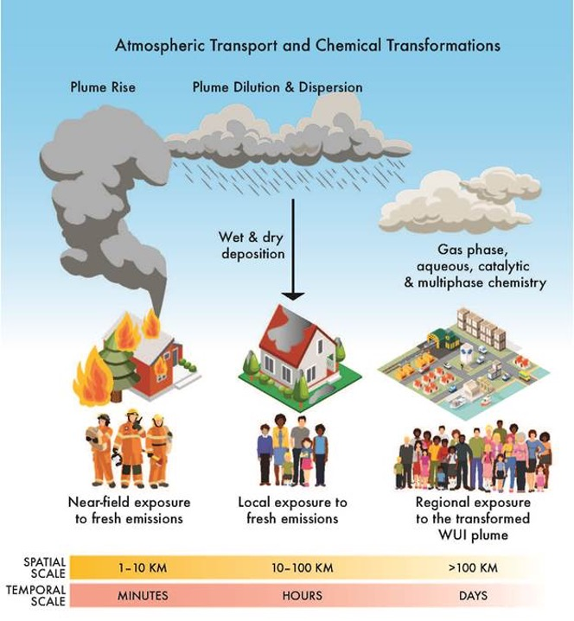
WUI fires
Our direct knowledge of WUI emissions is based on extrapolations and inferences from what is known of wildfires and urban fires.
  Differences in composition of fuels
  Differences in fuel loadings
  Differences in combustion conditions
  Differences in atmospheric transformations
  Differences in exposures and health effects
Notes:
General population, emergency response workers, cleanup recovery workers,
Exposure routes inhalation, ingestion, dermal absorption
Distribution: immediate and near field, local and regional (10-1000km) continental (more than 1000km)

Slide 6
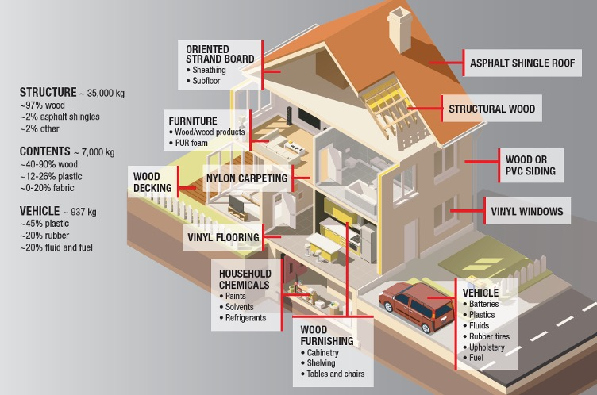
Fuels and Emissions from WUI fires

Slide 7
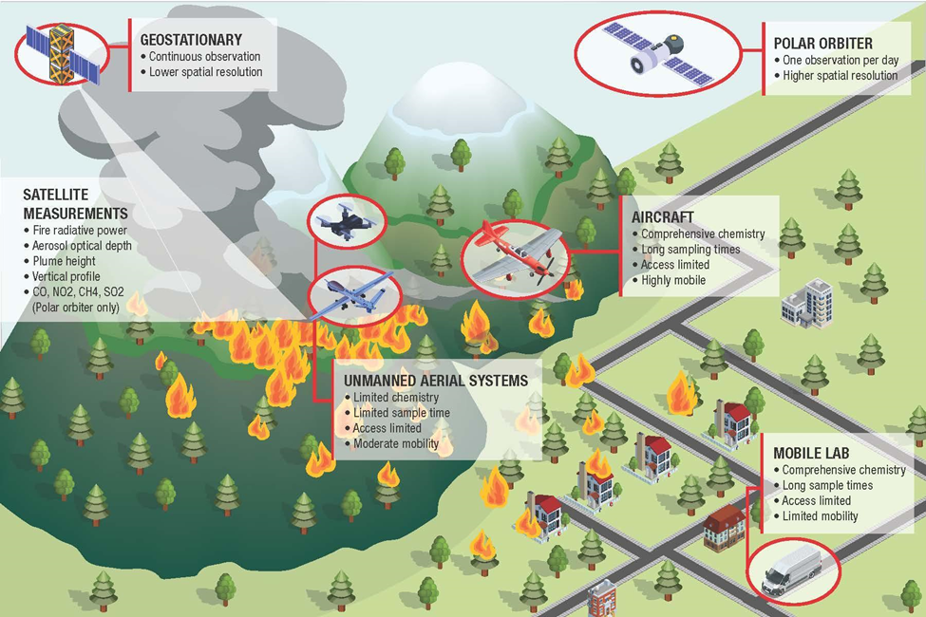
Fuels and Emissions from WUI fires
Notes:
Peat emissions: CO, HCN, Nox, formaldehyde, PAHs, VOCs, PM

Slide 8
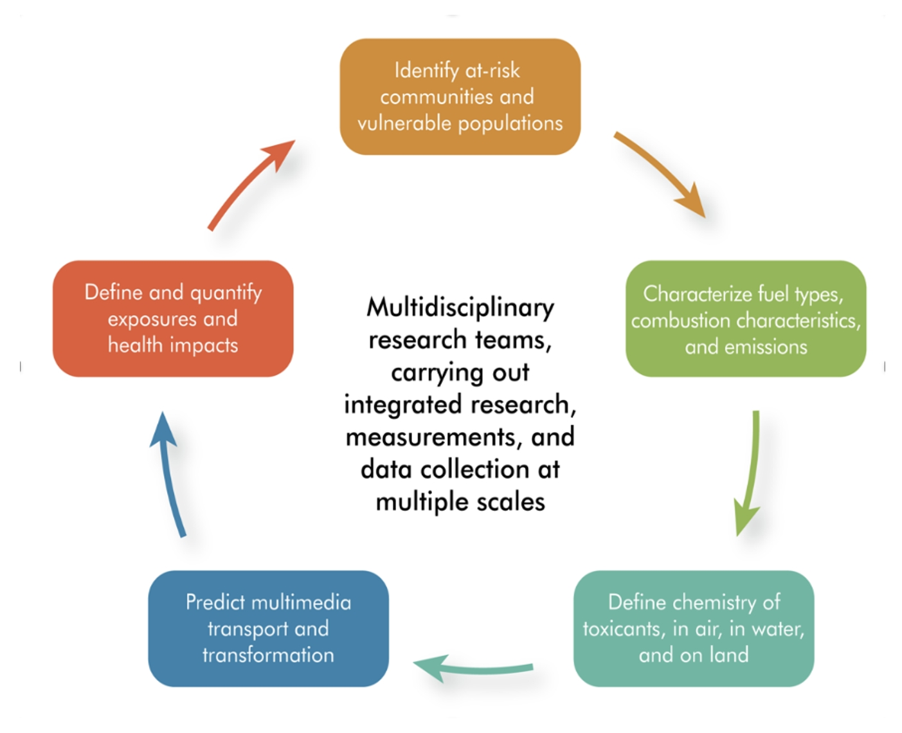
Research priorities
 | FUELS AND EMISSIONS | CHEMISTRY, TRANSPORT, AND TRANSFORMATIONS | EXPOSURE AND HEALTH | MEASUREMENT SCIENCE AND ANALYTICS
Collecting WUI-specific data | Assemble data on fuels, emissions, chemistry, transformations, exposure, and health impacts that are attributable to fires at the WUI, differentiated from wildland fires and urban fires, which will require novel measurements and analyses
Fundamental measurements and data | Identify combustion conditions and emissions typical of WUI fires Examine interactions between human-made fuels and wildland fire fuels using mechanistic models and experiments at bench, and larger scales | Identify primary and secondary toxicants emerging from WUI fires | Improve understanding of indoor penetration and composition of WUI fire smoke Evaluate health implications of smoke constituents, and exposure to constituents in water | Develop new analytical capabilities for measuring chemical, particle, and biological indicators of WUI fire toxicants
Field and population studies | Assess fuels, consumption, and emissions of WUI fires | Identify the key precursors and formation pathways of secondary species with toxic potential, Identify key chemical species that can impact water and soils | Characterize multi-route and multimedia exposures and health impacts Improve understanding of acute and long-term health effects of WUI fire toxicant exposures | Develop biomarkers specific for WUI fires that can be used for exposure and toxicity assessment
Prediction, assessment, and exposure-mitigation capabilities | Develop risk assessment procedures for WUI fires Develop predictive models of WUI fire combustion and emissions | Create improved retrospective and prospective models of WUI fire exposures Evaluate risks to community water systems and response plans | Measure the effectiveness of interventions for firefighters Expand identification of vulnerable populations and culturally appropriate interventions | Deploy multi-scale sensing capabilities to assess chemical compositions of WUI fire plumes

Slide 9

Committee Recommendations
Researchers and agencies: an integrated, multidisciplinary research agenda.
Novel measurements and analyses for WUI data on fuels, emissions, exposure, and health impacts.
Agencies and investigators: widely accessible repositories for data and information relevant to WUI fires.
Best practices for mitigation measures, and best practices for information dissemination.
Policy-relevant research findings, and for decision-makers working with at-risk communities and vulnerable populations.
Notes:
To understand the chemistry, exposures, and health impacts of toxicants resulting from WUI fires,
Assemble data on fuels, emissions, chemistry, transformations, exposure, and health impacts that are attributable to fires at the WUI, differentiated from wildland fires and urban fires, which will require novel measurements and analyses

Slide 10
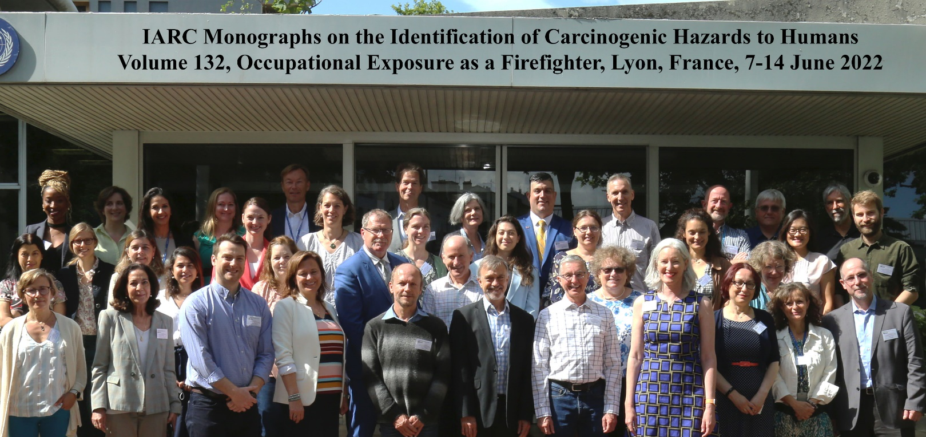
Firefighters and their health
2022: International Agency for Research on Cancer (IARC) has classified occupational exposure as a firefighter as carcinogenic to humans (Group 1)

Slide 11
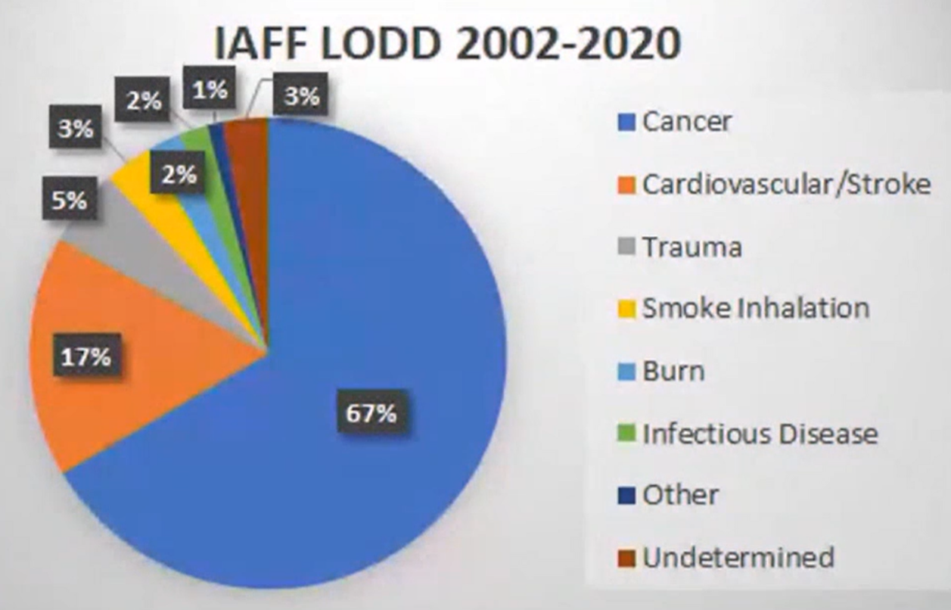
Firefighters and their health
International Association of Firefighters
Notes:
Line of duty firefighters

Slide 12
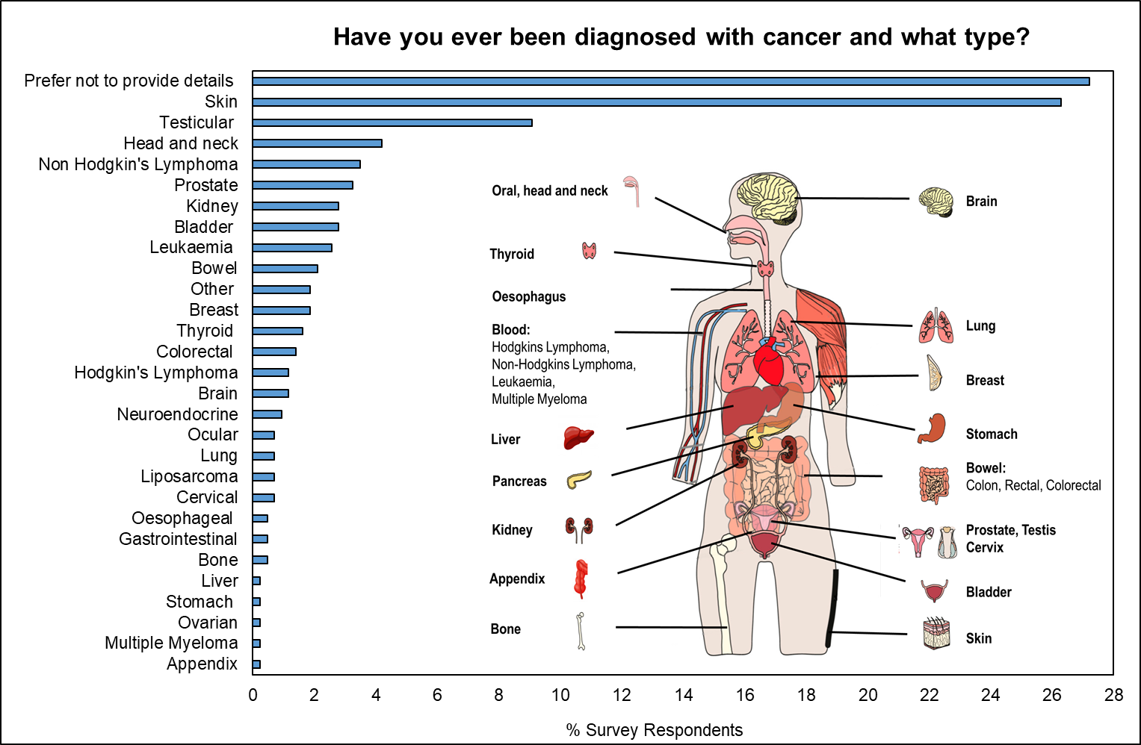
Cancer Incidence-Survey Results
Over 4% of UK serving firefighters who responded to the survey have already been diagnosed with cancer.
98% of UK serving firefighters who responded indicated they do not smoke.

Slide 13
UK Firefighters and their death

Slide 14
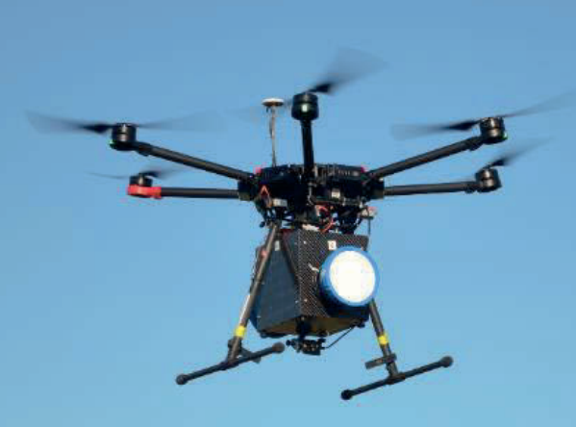
Peat Fires
Gas (Emissions) Monitoring
Personal Monitoring
Soil (and Water) Monitoring
Exposure Monitoring

Slide 15
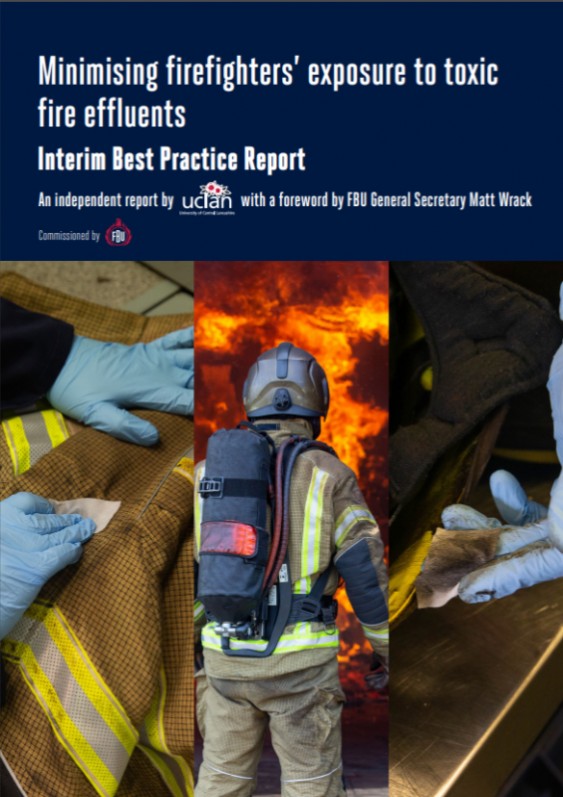
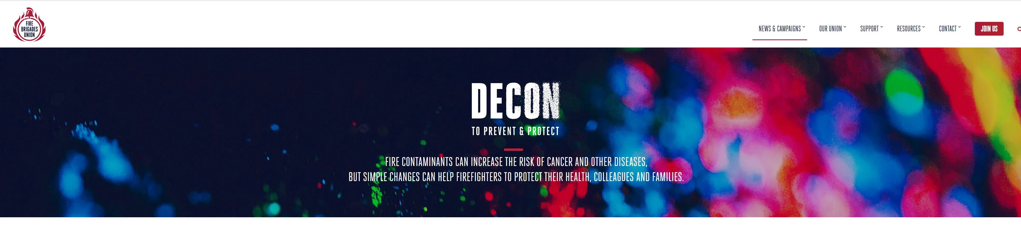
Thank you for your attention
aastec@uclan.ac.uk
Notes:
15

