Slide 1
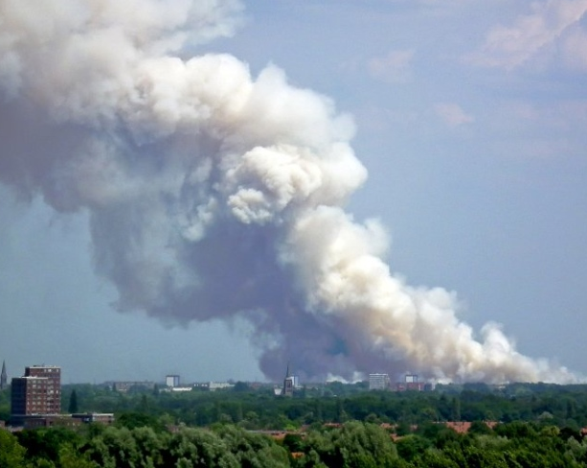
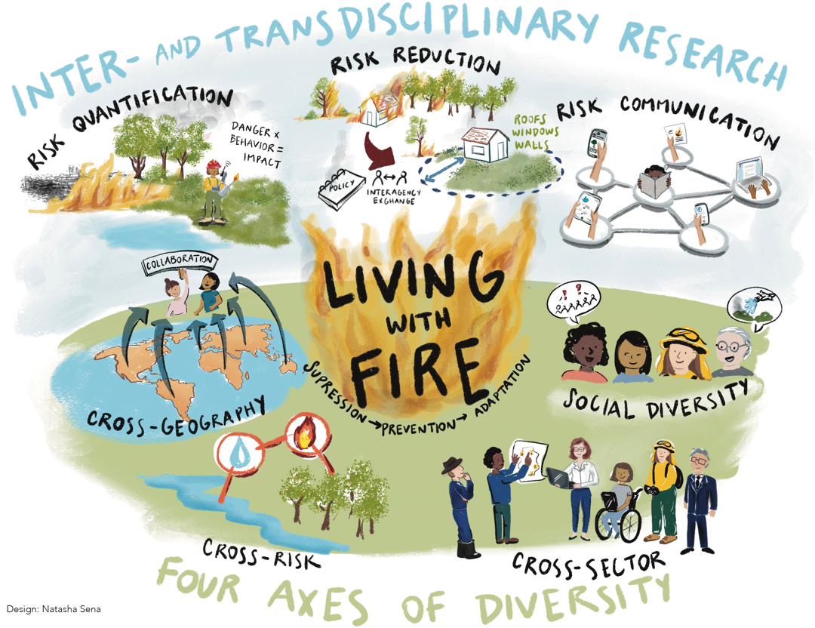
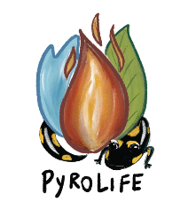
Living with fire and the need for diversity: lessons learned from PyroLife
Living with fire and the need for diversity: lessons learned from PyroLife
Cathelijne Stoof, Fiona Newman Thacker, Nick Kettridge, and the PyroLife team
PyroLife@wur.nl Cathelijne.Stoof@wur.nl

Slide 2
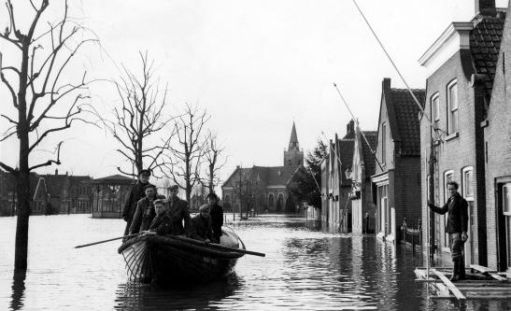
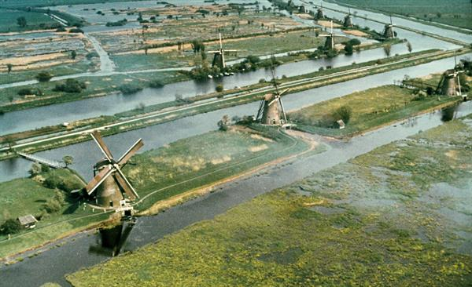
Observations & needs
Fires in the usual fire countries going beyond control
Fires burning in the unusual fire countries amidst high population density, low awareness & preparedness
Knowledge exchange: ‘We are unique’ // physics are the same
Same language, just a different dialect – Marc Castellnou

Slide 3
Zooming in on The Netherlands
Highs and lows, some years jump out
Analyzing patterns, trends 1922-1945
Data collection ended in 1994
2002: Bosbrandverordening terminated
With thanks to WUR library, Probos, Phoebe Thomas

Slide 4
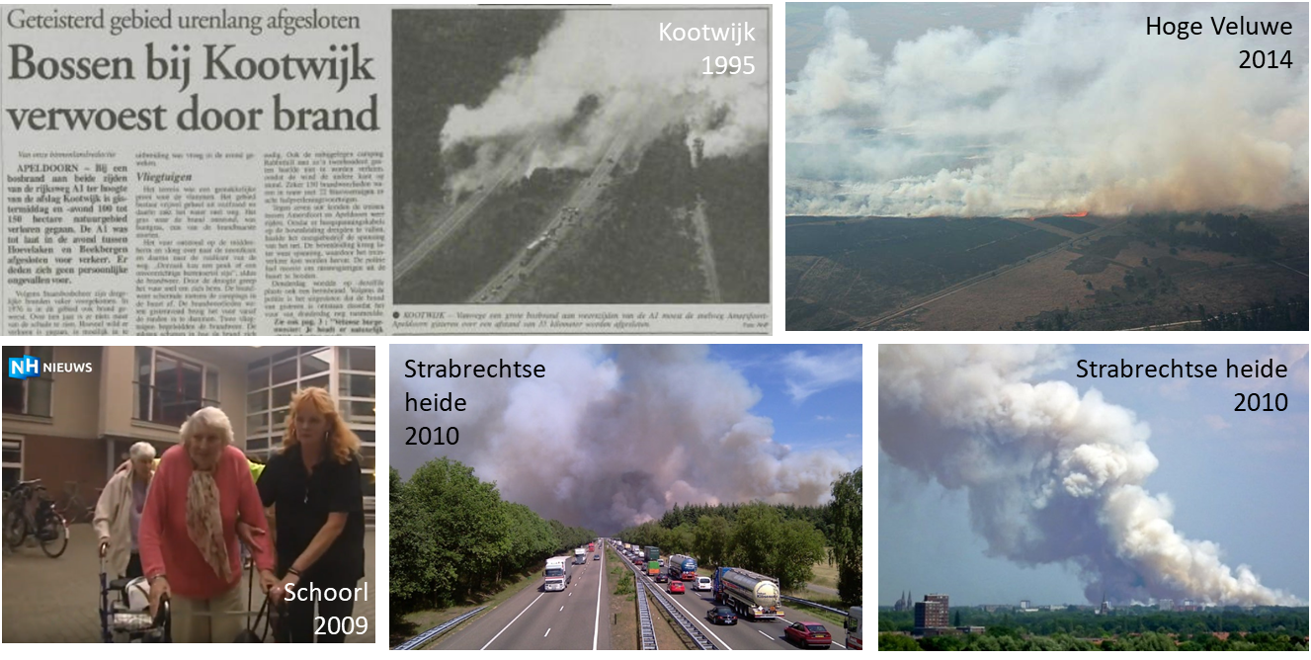
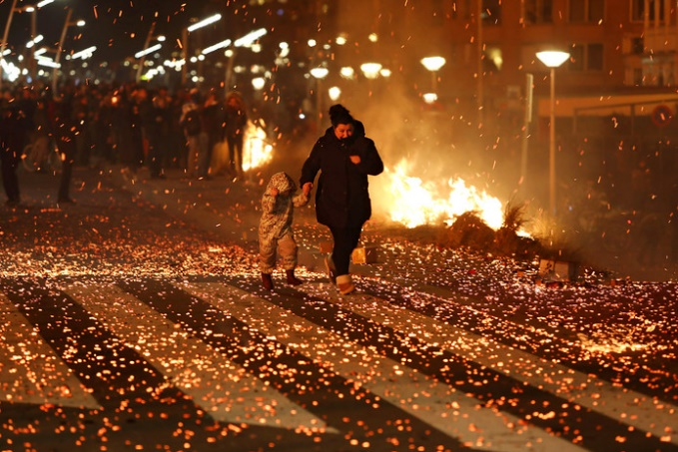
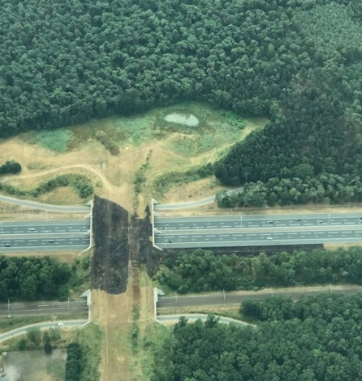
But fire does not disappear
#Scheveningen
How often does it burn? Where? Why?
Effect of climate change? What is good prevention?
You’re nowhere without data
Woudenberg

Slide 5
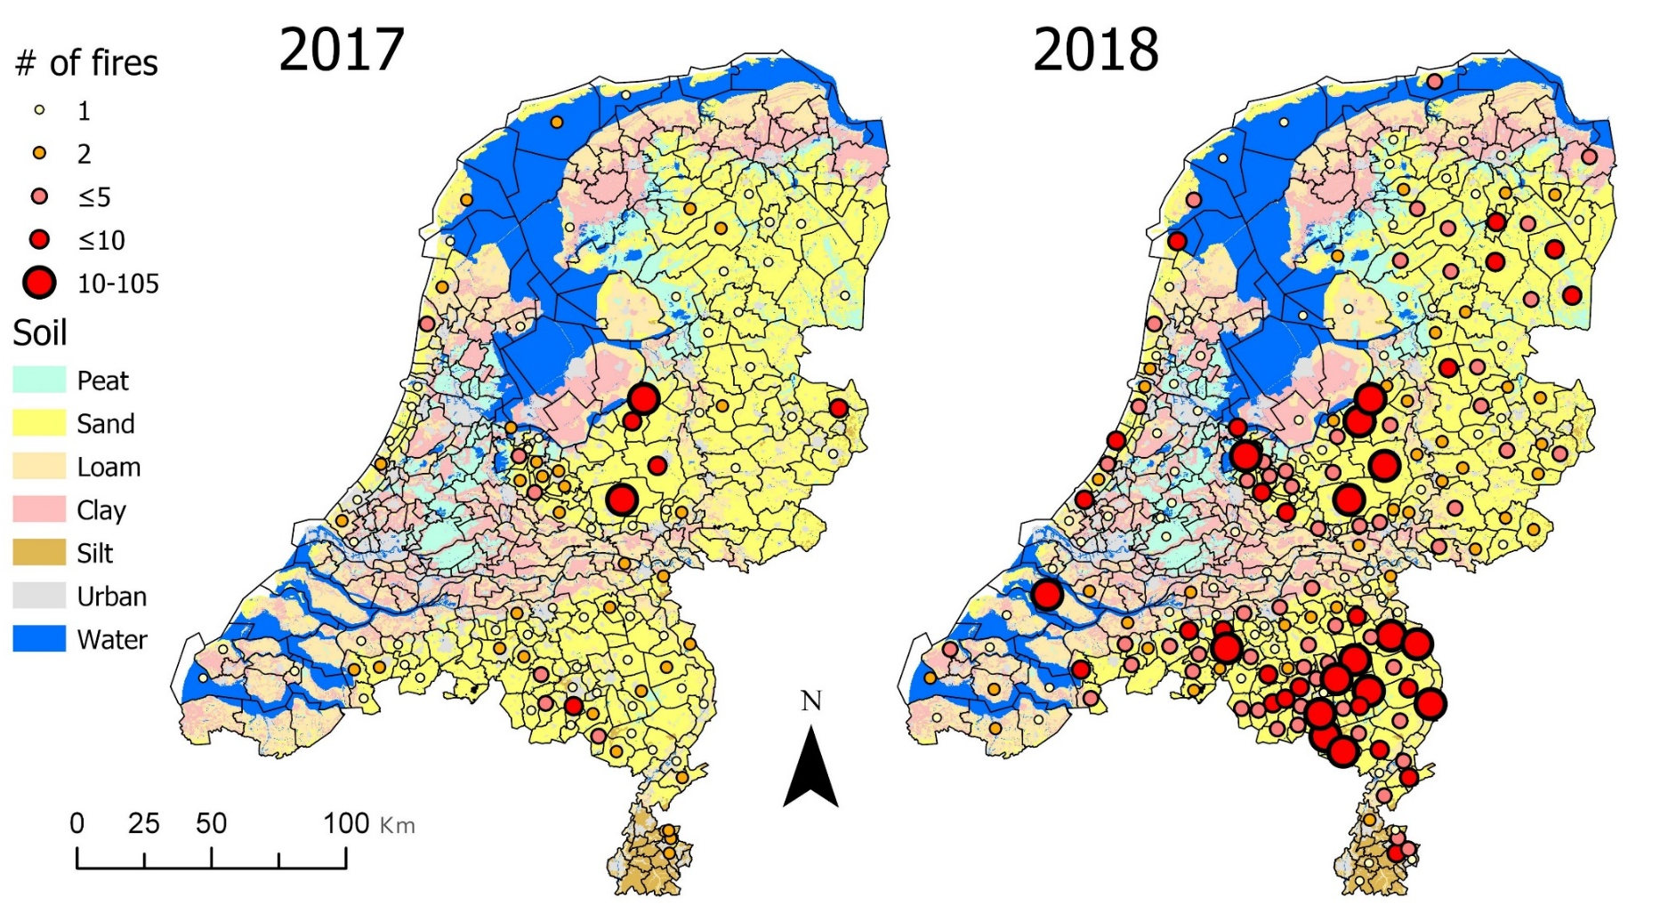
2017-now
Informal collaboration NIPV-WUR (Kok & Stoof); data used to answer parliamentary questions, but data collection not secured
Landscape fires concentrated on high sandy soils
Stoof & Kok, 2018
EFFIS report 2019

Slide 6
2017-now
200-1000 fires/year, 50-1100 hectare
3 orders of magnitude higher than satellite estimates
Mostly in Spring (2018, 2022: also Summer)
17% on Sunday (14% average)
90% very small, < 1 hectare
Heathland > forest
Caused by people, few official investigations
We count *all* wildfires, regardless of size, duration, resources deployed
Stoof et al, in prep

Slide 7
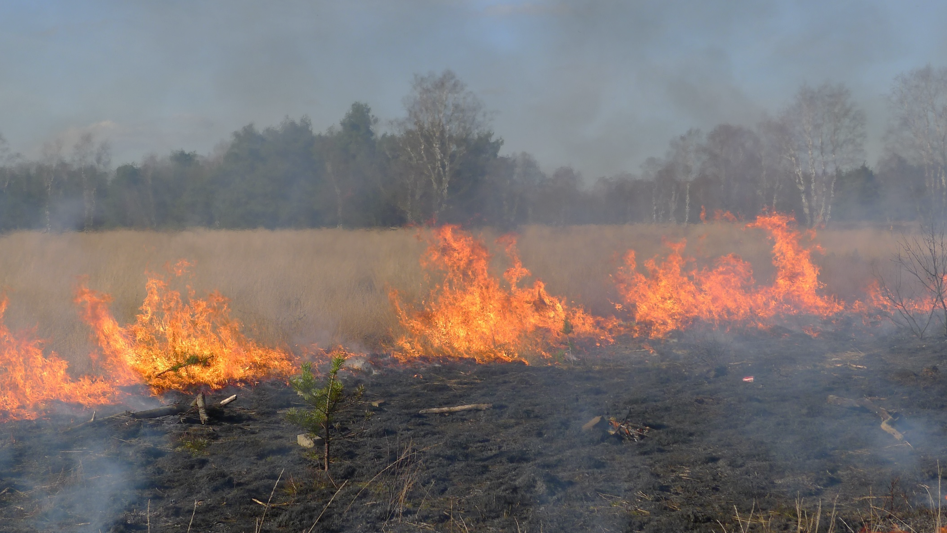
Key challenges for NW Europe
a LOT has happened the last 10 years – NL examples:
Landelijke vakgroep ministry LNV
Importance of topic boosted in National Safety Analysis
Fire absent in planning, design and education
Problem ownership is unclear
Which DG, ministry, government level is responsible?
Enthusiasm but resistance to knowledge
Reinventing the wheel, ill-informed projects
Belief that all fire is bad, can be suppressed, can be solved with a bicycle path, fire service will rescue us
Focus on the fires we’re having now, not on what it about to come

Slide 8
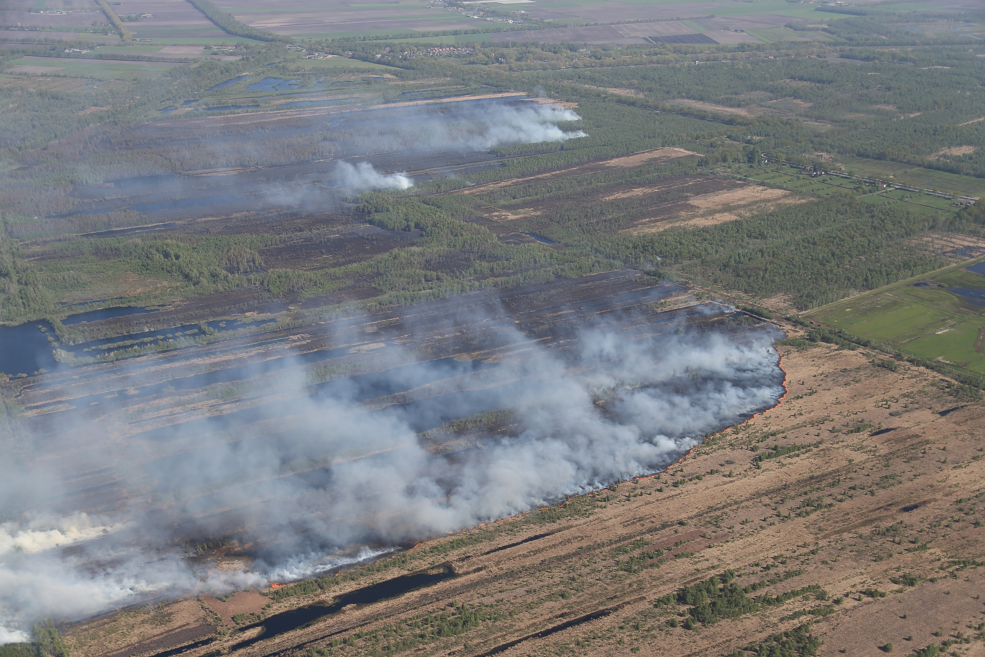
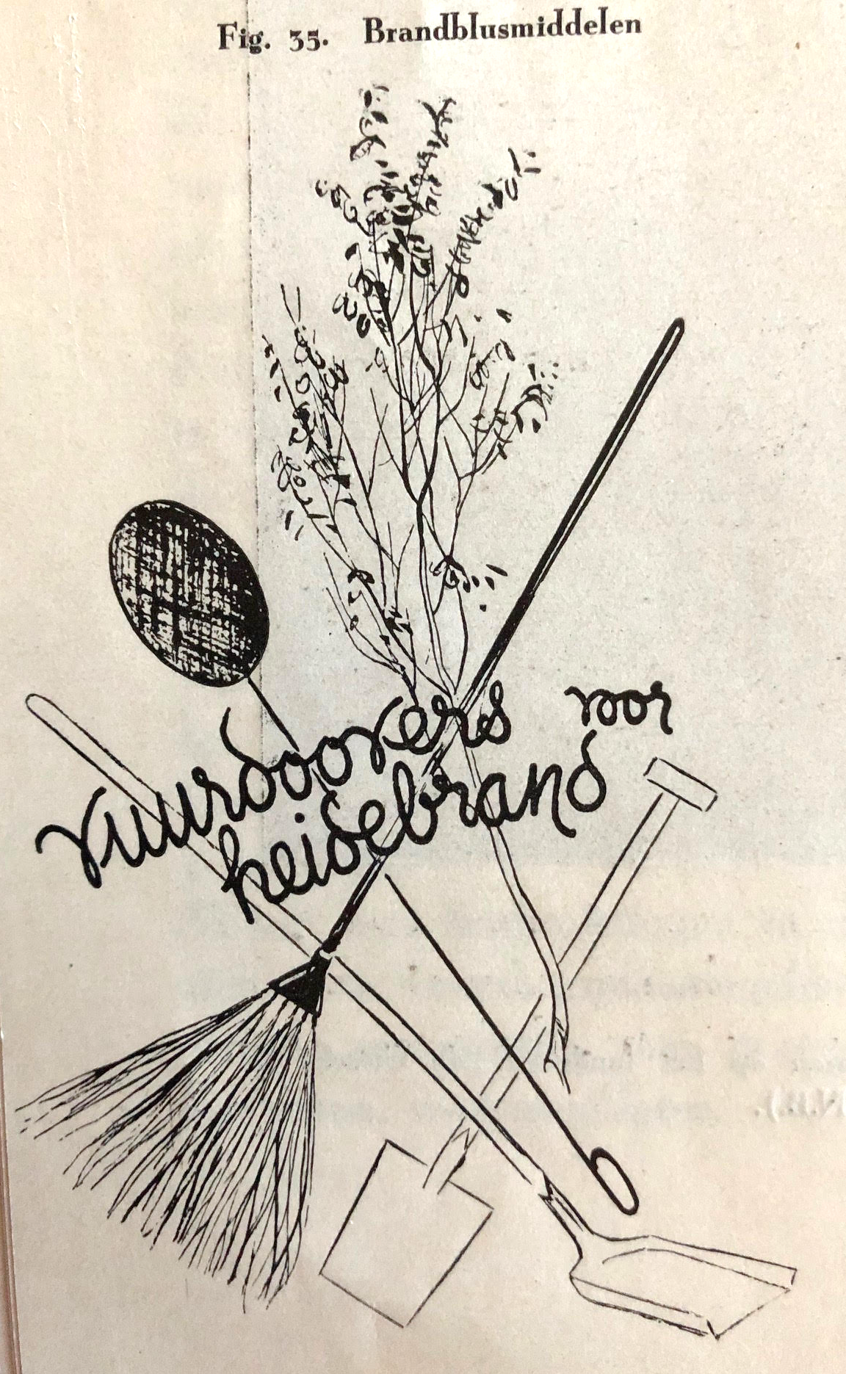
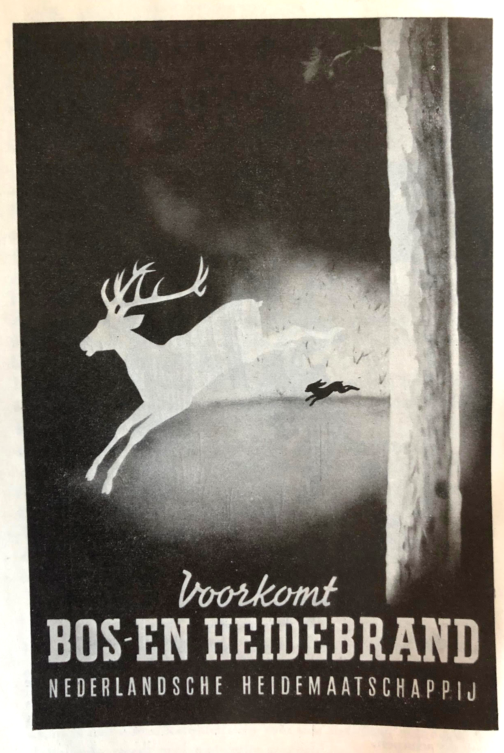
Knowledge exchange
Strong need for knowledge exchange
Wildland fire is very different from structural fire (urban fire)
Deurnese Peel fire 2020 recommendations:
Innovate fire management
Integrated approach
Involve residents, better communication
Based on international best practices
Learn from others, and from our own past
Stoof et al 2020

Slide 9
Observations & needs
Almost everything has been done before
Learn from mistakes and successes elsewhere
Knowledge exchange between countries, disciplines, people
Need to train people to make connections, bridge knowledge
4 M€, 15 early stage researchers
Wageningen Univ. + 20 partners

Slide 10
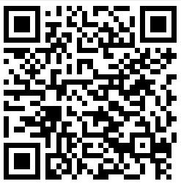
Stoof & Kettridge 2022
Earth’s Future

Slide 11
Social diversity
Need to hear all voices in science & practice, across disciplines
Fire suppression masculine and heroic
Need for more feminine approaches – building relationships
More diverse people than traditionally involved in fire
Visibility – Combating bias – Safe working climate

Slide 12
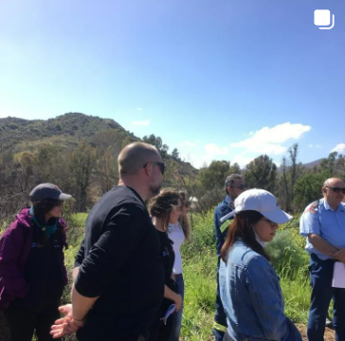
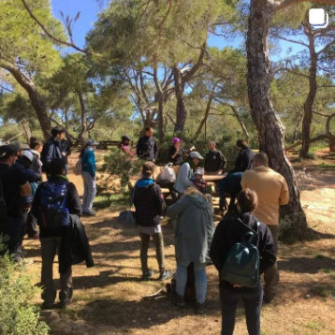
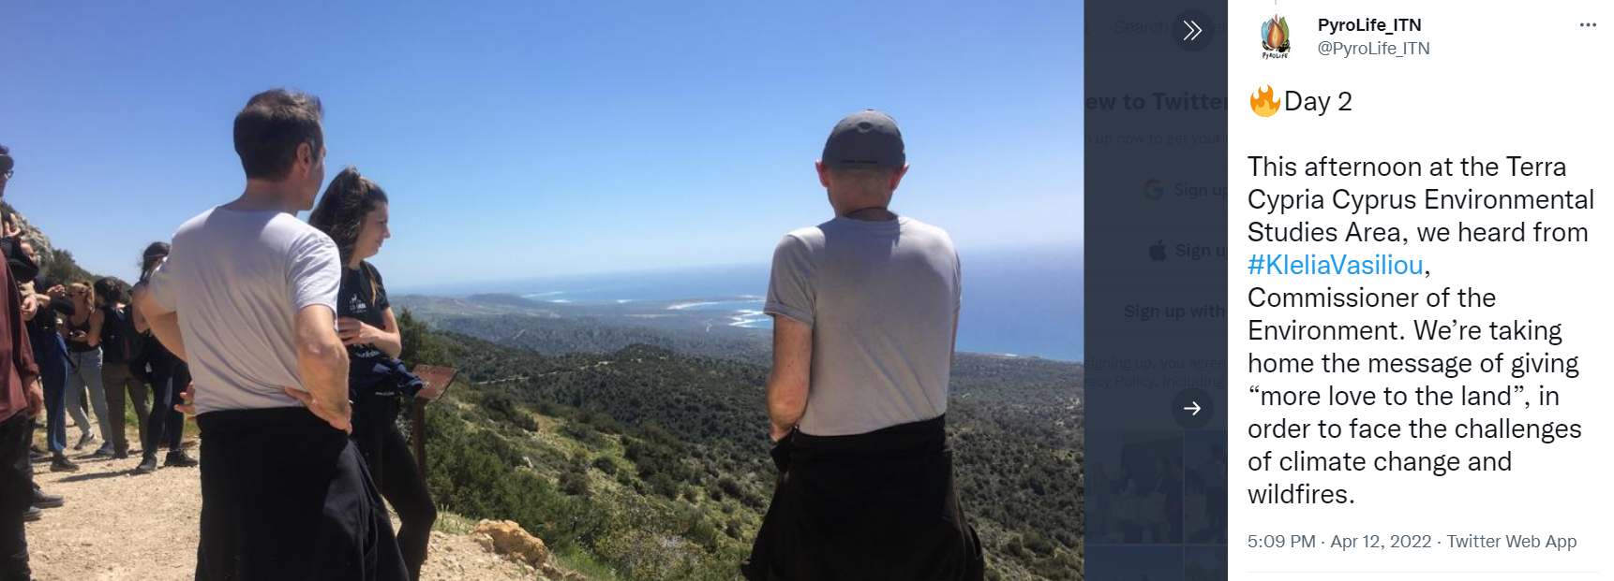
Four axes of diversity - implications for training
Current training often monodisciplinary
Need mono-, inter-, and transdisciplinary experts who can
understand social and environmental drivers and impacts of fire
deal with uncertainty, knowing the unknowns
communicate risks
integrate across disciplines, sectors and countries
Speak the same language, integrate at team level
15 early-stage researchers in engineering, environmental & social science
Integrated training
Two secondments (north/south, science/practice)

Slide 13
Lessons learned - current discussions
Why is integrated fire management not the norm?
Takes time, trust, respect, common interest, language, opportunities to meet & learn, listening is essential
Not catchy, not seen as innovation. Hard to compete with shininess of technology
How do you want your fire? What does that mean for the landscape?
Find common interests, opportunities to meet, connect w big themes, mutual benefits
Universal vs. local
What knowledge, methods can be adopted, what needs to be adapted
Context is essential, history – what is going on in a region, developments, tensions. Fire and its solutions do not exist in a vacuum

Slide 14
Lessons learned - current discussions
What diversity is needed
Who should be at the table? What questions should be asked?
Who determines this? Role of power, knowledge
How to organize this, who takes the initiative (vs. pointing at others)
‘Whoever feels the urgency’
National framework/ guidance, local implementation
Local developments faster, people know eachother
Arrange this – in whichever way works best locally
Keep pushing it in your own organization
Impossible to live with all fire – cannot adapt & mitigate everything – suffering

Slide 15
“Mitigation, Adaptation, or Suffering” Fiona Newman Thacker, Kathleen Uytewaal, Tomas Quinones Perez with Bethany Hannah, Rik Leemans, Cathelijne Stoof
“We basically have three choices: mitigation, adaptation and suffering. We’re going to do some of each. The question is what the mix is going to be. The more mitigation we do, the less adaptation will be required and the less suffering there will be.”
-John Holdren, Launch of IPCC Report (2007)
Mitigating wildland fires: GHGs and ignitions
Detracts focus from “living with fire”
Reframe: mitigating extreme and severe impacts of wildland fires…

Slide 16
Why suffering?
Climate change literature: focus on “vulnerabilities”, “exposure”, and “impacts”
Vulnerabilities: preconditions to suffering
Vulnerabilities = projected. Suffering = experienced.

Slide 17
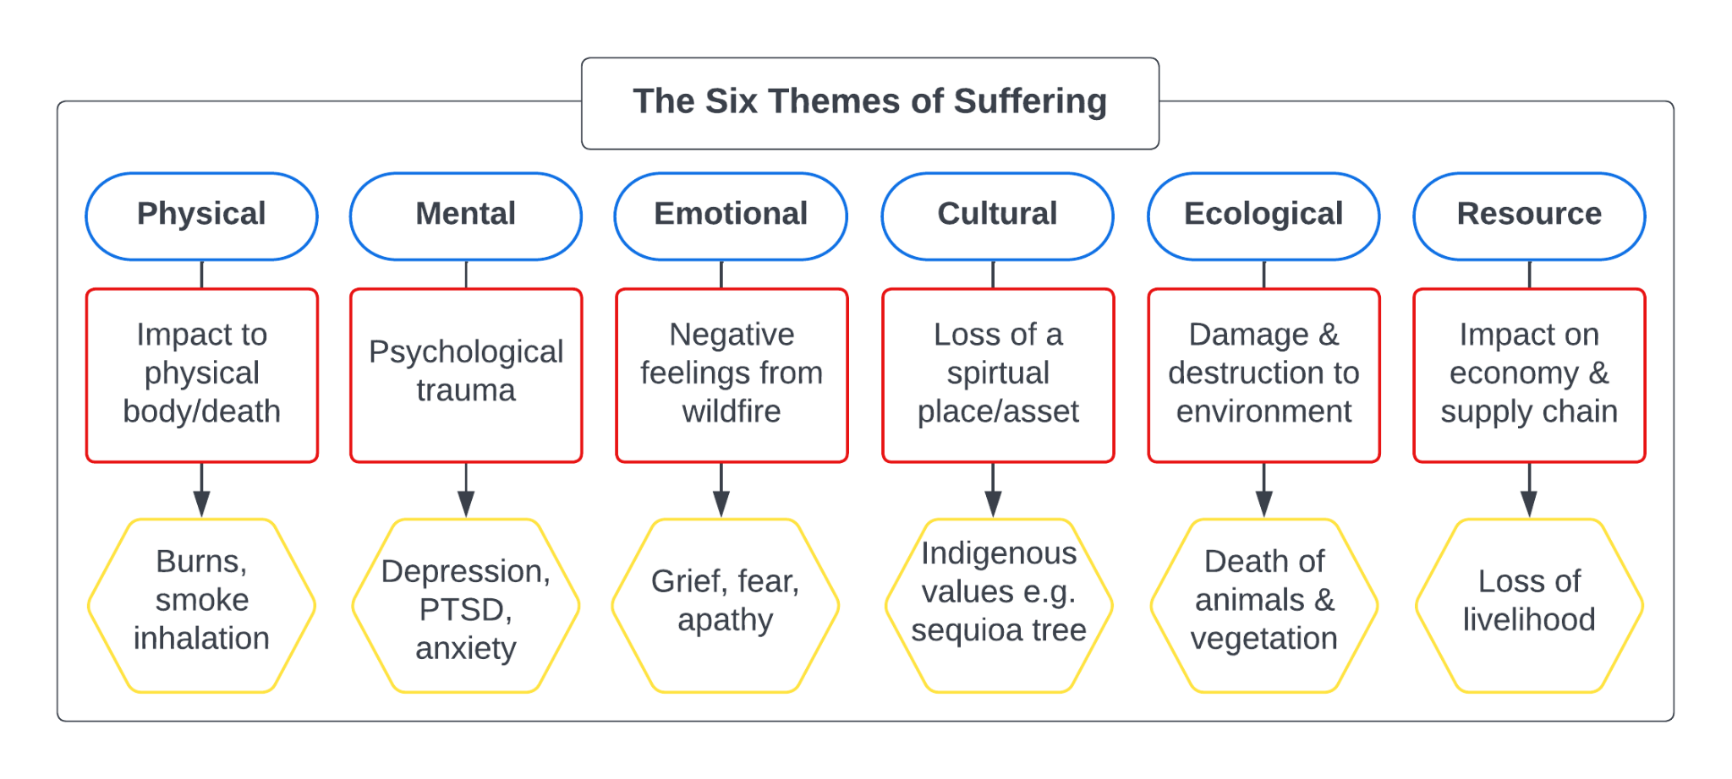
Suffering (diagram)

Slide 18
Adaptation is explored within many studies aiming to understand and develop the concept of ‘living with fire’ (Moritz et al, 2014; Smith et al, 2016; Tedim and Leone, 2017).
Change is vital if we are going to sustain societies in the face of oncoming wildfires.
Learning from other disciplines; agroecology.
Careful to avoid maladaptation.

Slide 19
Connecting Adaptation to Alleviate Suffering
Fort McMurray, Canada (2016)
Mental, physical - individual trauma
Social suffering
Cultural and ecological - First Nations losses
Resources - supply chain breakdown
Las Maquinas, Chile (2017)
Prior scientific knowledge – coproduction of knowledge
Good evacuation efforts – lessened physical suffering
Homogeneous landscape – more ecological suffering
Normally, adaptations should be proactive, but due to the current context of extreme fires, both proactive and reactive adaptation actions are occuring at the same time. Whether proactive or reactive, we need to avoid maladaptations.
Notes:
The main problem in Las Maquinas was that all the adaptations were designed for use within the fire event (temporal). Adaptations were not made before the event occured - no effort to increase vegetation heterogeneity or community resilience. Shows that if you only focus on global adaptations e.g. knowledge exchange but only apply it on a temporal scale of within the fire suffering will still occur.

Slide 20
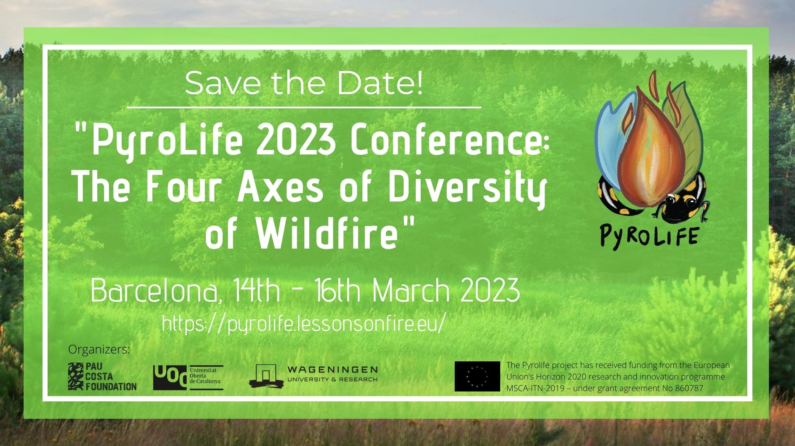
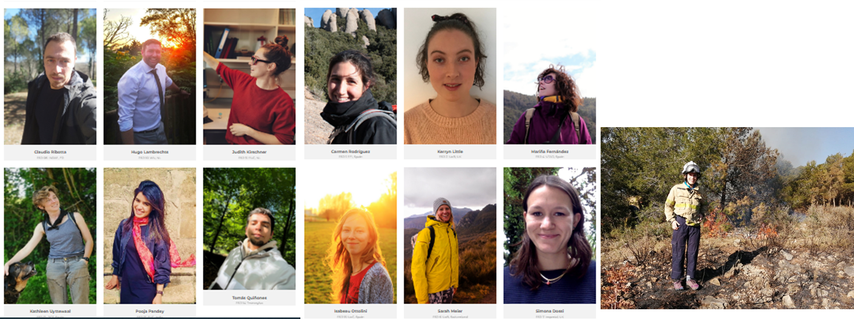
Take home
Cannot adapt and mitigate everything – acknowledge suffering & prepare for it
Living with fire requires acceptance of fire, integrated approach
Inter- and transdisciplinary research, four axes of diversity
Requires new way of training
Building upon strengths in science and practice
More questions than answers
PyroLife@wur.nl Cathelijne.Stoof@wur.nl
Well-trained researchers entering the job market in a few months!

Slide 21
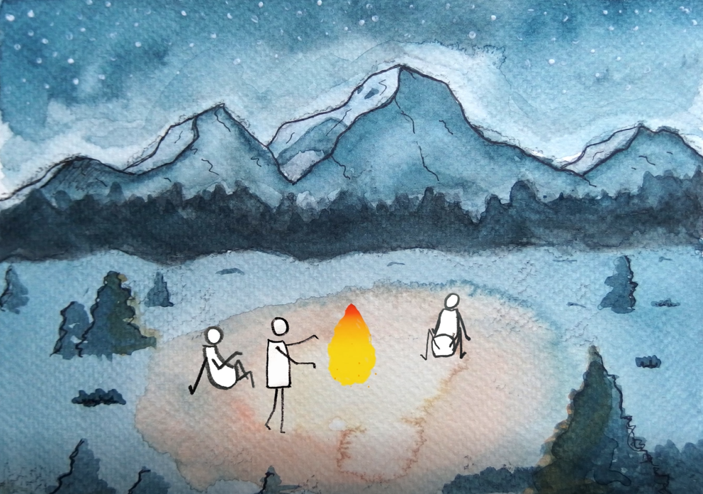
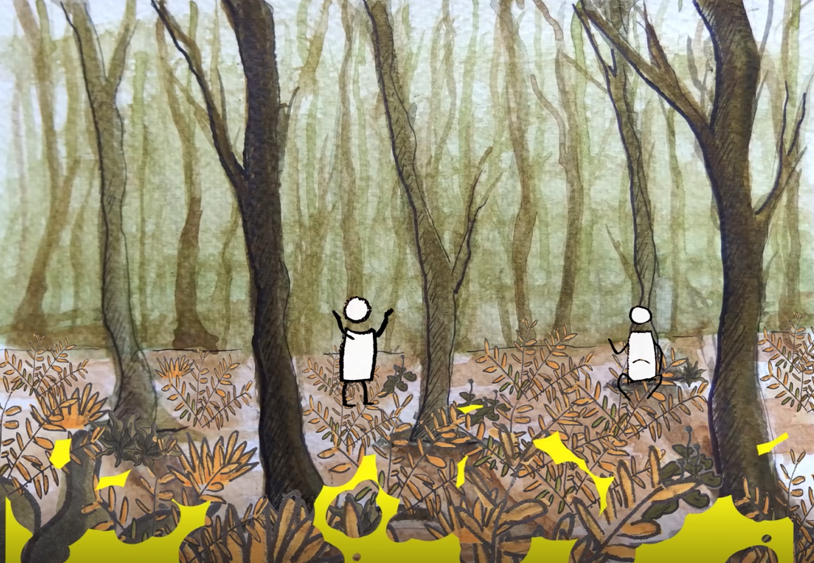
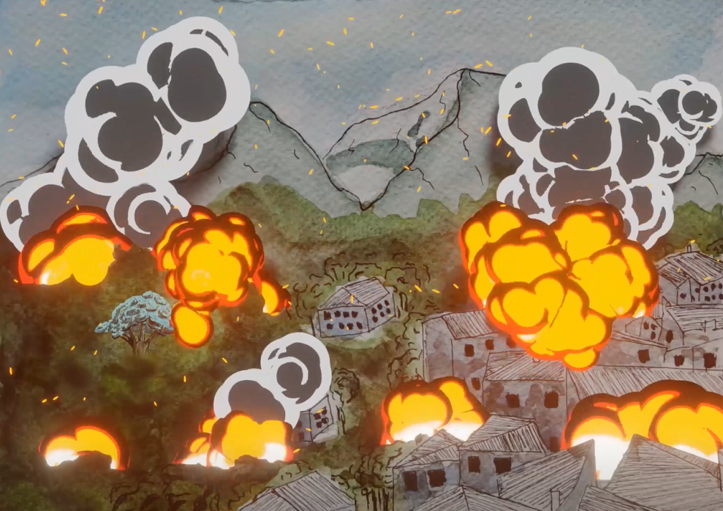
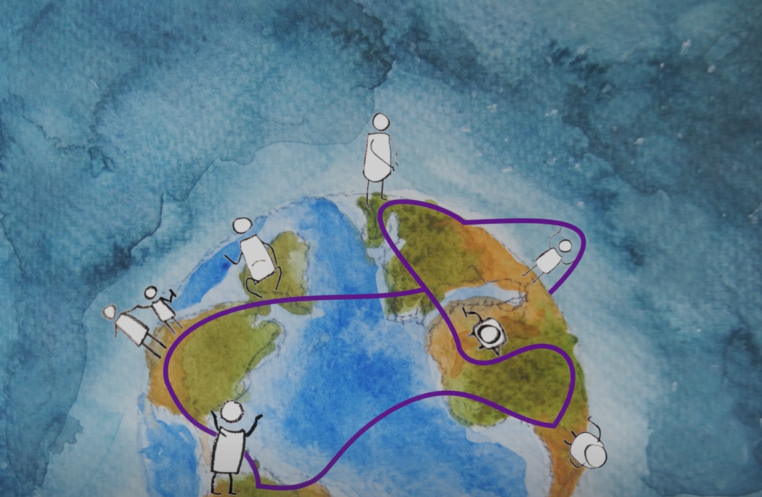
Spinoff - Pyrogeography Master course – Wageningen University
35 students from across the university
Bridging environmental & social science, arts
Tutored by international experts in practice
Learning together
Fire’s journey through time, by Lotte Hahn,
Jan Hooijmans, Sam Tuijtel, Ines Voelker

